Slide 1
Configuring Recommendations for Personalized Search at Sandia National Laboratories
Clay Pryor and Ryan Cooper
SAND2019-10363 C
Notes:
Ryan and Clay

Slide 3
Personalized Search at Sandia National Laboratories
Abstract
In the scope of enterprise search, the assumed preference of each user is the number of times that they have previously clicked on pages, an observed weight. This weight is then used to co-cluster (associate) with other users to make predictions about what pages they will be most likely to find useful based on their previous click history. This presentation will describe how we configured personalized search in days, not weeks, months, or even years. We will review the configuration process from data gathering and model building to the query configuration used to return personalized results to enterprise search customers. We will share results and interesting observations as well.
Clayton Pryor
Ryan Cooper

Slide 4
Agenda
What is Personalization?
What is Personalized Search?
Why does it matter in an Enterprise Search environment?
How we accomplished data-driven personalization natively within Fusion
Fusion configurations
Examples
Observations and Considerations
Next steps

Slide 5
What is Personalization?
Notes:
Clay’s perspective:
Provide customers with the information they need when they need it based on their history, profiles, demographics, and whatever other information we have or can gather about them (with permission and without getting too creepy!)
We have access to a lot of information about employees but does it make sense to use it even with permission?
Not just search results.
Can push the information they need when they login or any time during the day (or night).

Slide 6
What is Personalized Search?
Personalized search refers to search experiences that are tailored specifically to an individual's interests by incorporating information about the individual beyond the specific query provided.
Factors that could be used to influence personalized search include:
Query History
Click History
Location
Social Media
HR Data (if acceptable)
Organizational Data

Slide 7
Why does it matter in an Enterprise Search environment?
Google does it – personally, I don’t like this answer ☺
We can provide you with results that are more useful to you than the standard results
We can predict what you might be interested in without you even asking
Perhaps we can improve your safety and security

Slide 8
How we accomplished data-driven personalization natively within Fusion
Capture Signals
Aggregate Signals
Create a user-weighted documents collection
Train ALS Recommender Model
Generate “Items for Users” Recommendations
Incorporate Recommendations into Query Pipeline to Influence Results

Slide 9
Configurations of a sample
personalized search pipeline
within Fusion

Slide 10
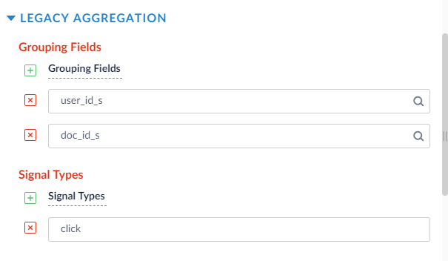
Create a user-weighted documents collection
Job: Signals Aggregation

Slide 11
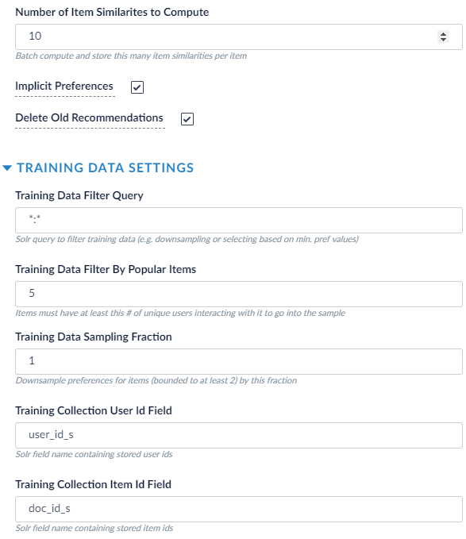
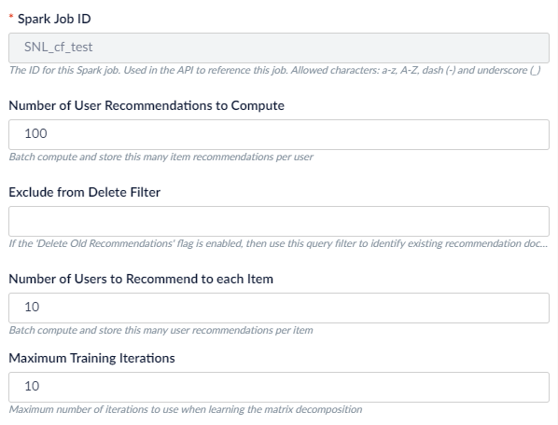
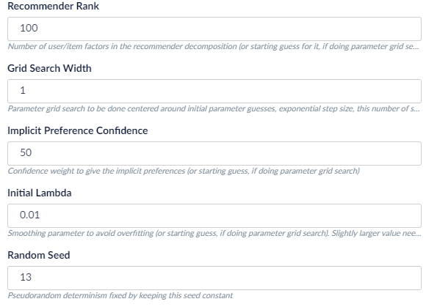
Train ALS Recommender Model
Job: ALS Recommender

Slide 12
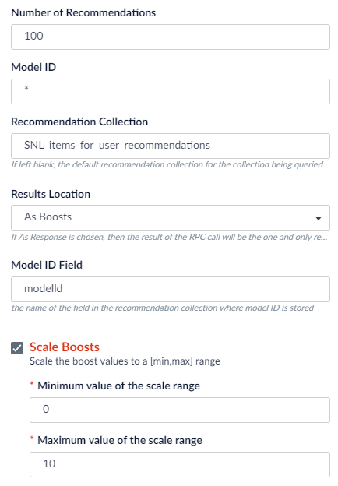
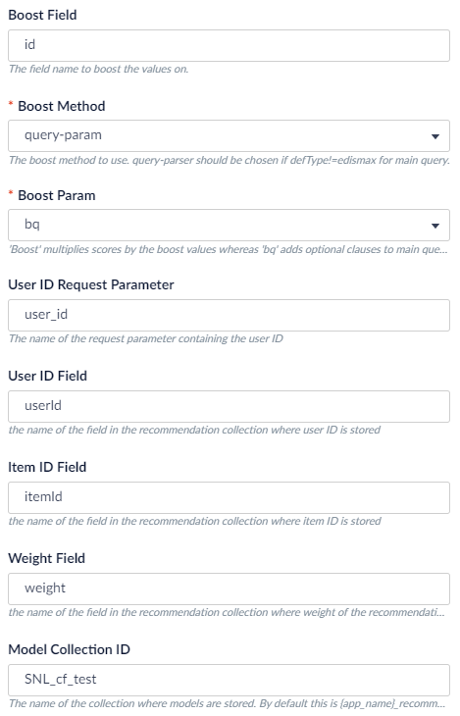
Generate “Items for Users” using the resulting collection from ALS model
Query Pipeline Stage:
Recommend Items for User

Slide 13
Examples

Slide 14
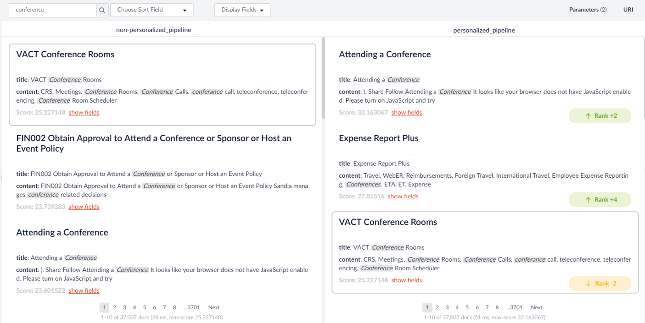
Results - Example – “Anonymous” v. Frequent Conference Goer

Slide 15
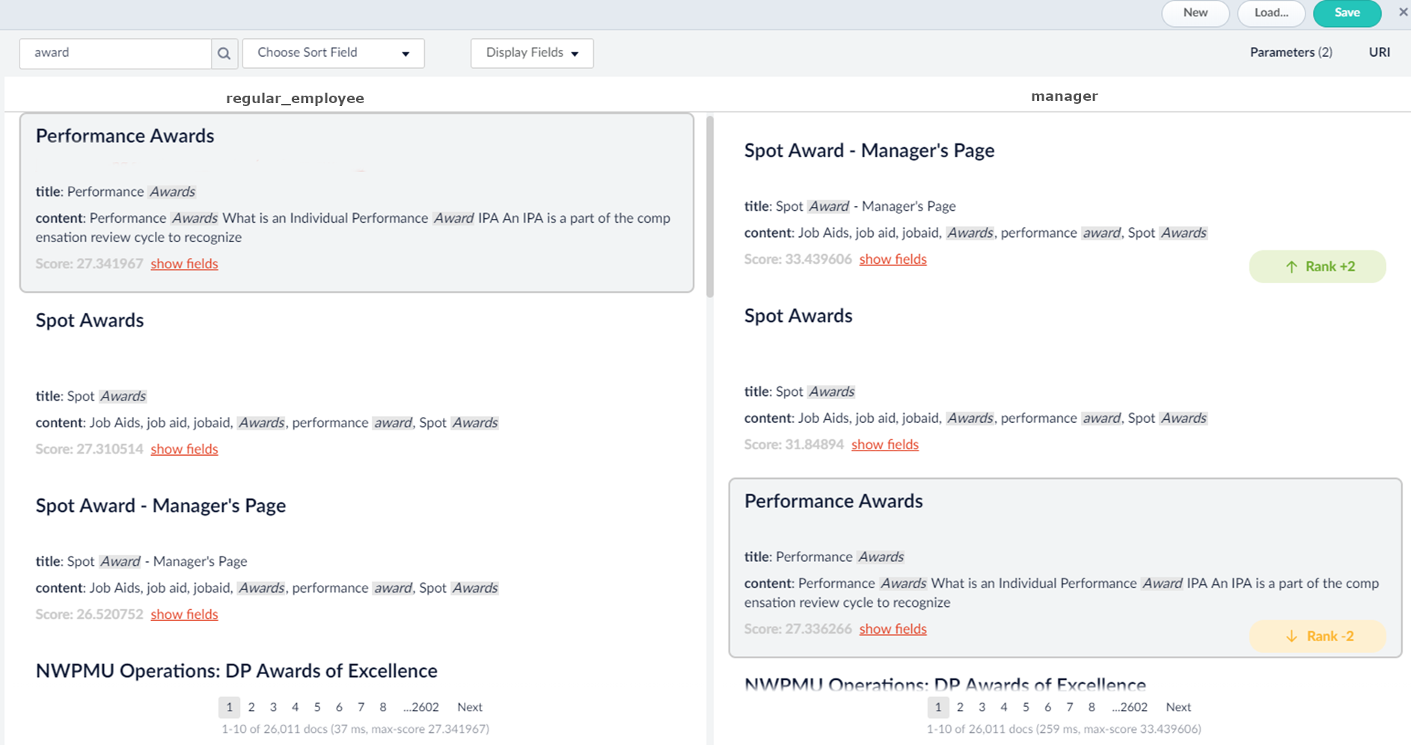
Results - Example – Regular Employee v. Manager

Slide 16
Observations
It worked! The results change when personalization is enabled.
This personalization is not based solely on the current user’s click history but what other individuals with similar interests clicked on
This approach produces “inferences” of what the current individual might be interested in
Similar types of users had similar recommendations
Frequent Conference Goers
Managers
Level of personalized results is configurable
A user with no click history is given standard search (no personalization).

Slide 17
Considerations
The model generates a query-agnostic list of recommended documents and scores.
Only documents that pass the query parsing stage will receive a boost, implying that irrelevant documents to the query will be filtered out, and thus not boosted.
However, pages will be boosted whenever they pass the query parser.
i.e. if https://www.example.com/ appeared in the queries “foo” and “bar”, it will be boosted in both.

Slide 18
Next Steps
We have a policy not to introduce changes into our search application until we evaluate them
Changes must not hurt the search results and, hopefully, they should improve the search results
Compare to Golden Standard - We have a tool that will evaluate changes in search results based on how well they match what experts list as the most desirable results for selected queries.
Golden Standard does not work when results change depending on who is currently using the system!
Must consider alternatives such as
Focus Groups
A/B Experiments

Slide 19
References
https://doc.lucidworks.com/fusion-ai/4.1/user-guide/boosting/index.html
https://en.wikipedia.org/wiki/Implicit_data_collection
https://en.wikipedia.org/wiki/Recommender_system
https://medium.com/radon-dev/als-implicit-collaborative-filtering-5ed653ba39fe
https://lucidworks.com/2017/08/24/machine-learning-model-training-and-prediction-using-lucidworks-fusion/

Slide 20
THANK YOU

Slide 21
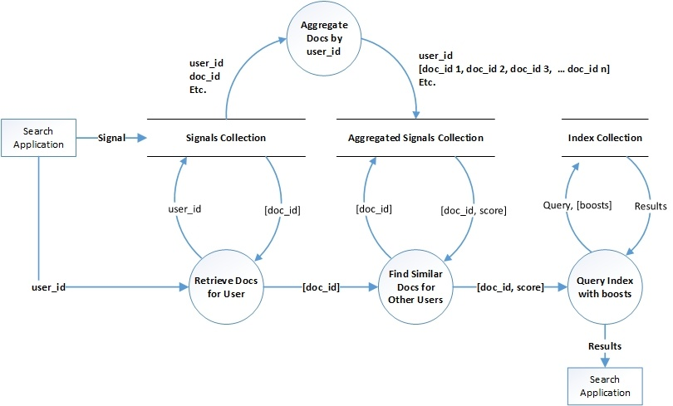
Previous Approach
Previously, Clay had demonstrated personalization by using custom solr sub-queries to lookup and do collaborative filtering on-the-fly from within the query pipeline.
In this approach, there are three mechanisms occurring:
$f :user→\{{page}_{0},…,{page}_{n}\}$
Gather user click history, a set of n pages
$g :\{{page}_{0},…,{page}_{n}\}→\{\left({page}_{0}, {score}_{0}\right),…,\left({page}_{m}, {score}_{m}\right)\}$
Find related documents based on collaborative-filtering-like solr query.
$h :\left(query,\left\{\left({page}_{0}, {score}_{0}\right),…,\left({page}_{m}, {score}_{m}\right)\right\}\right)→({page}_{0},…,{page}_{n})$
Query the index with additional boosts from the related documents.

Slide 22
Approach
Fusion provides an ALS (alternating least squares) collaborative filtering job that trains a model to recommend pages for users.
By pretraining this model, it essentially accomplishes the functionality of both f and g from the previous approach, while also eliminating the runtime computation.
It also simplifies the mechanism.
$a :user→\{\left({page}_{0}, {score}_{0}\right),…,\left({page}_{m}, {score}_{m}\right)\}$
Evaluate the model with the user to get a list of recommended pages and scores
This is essentially a composition of f and g from the previous approach
$b :\left(query,\left\{\left({page}_{0}, {score}_{0}\right),…,\left({page}_{m}, {score}_{m}\right)\right\}\right)→({page}_{0},…,{page}_{n})$
Query the index with additional boosts from the recommended pages.

